Slide 1
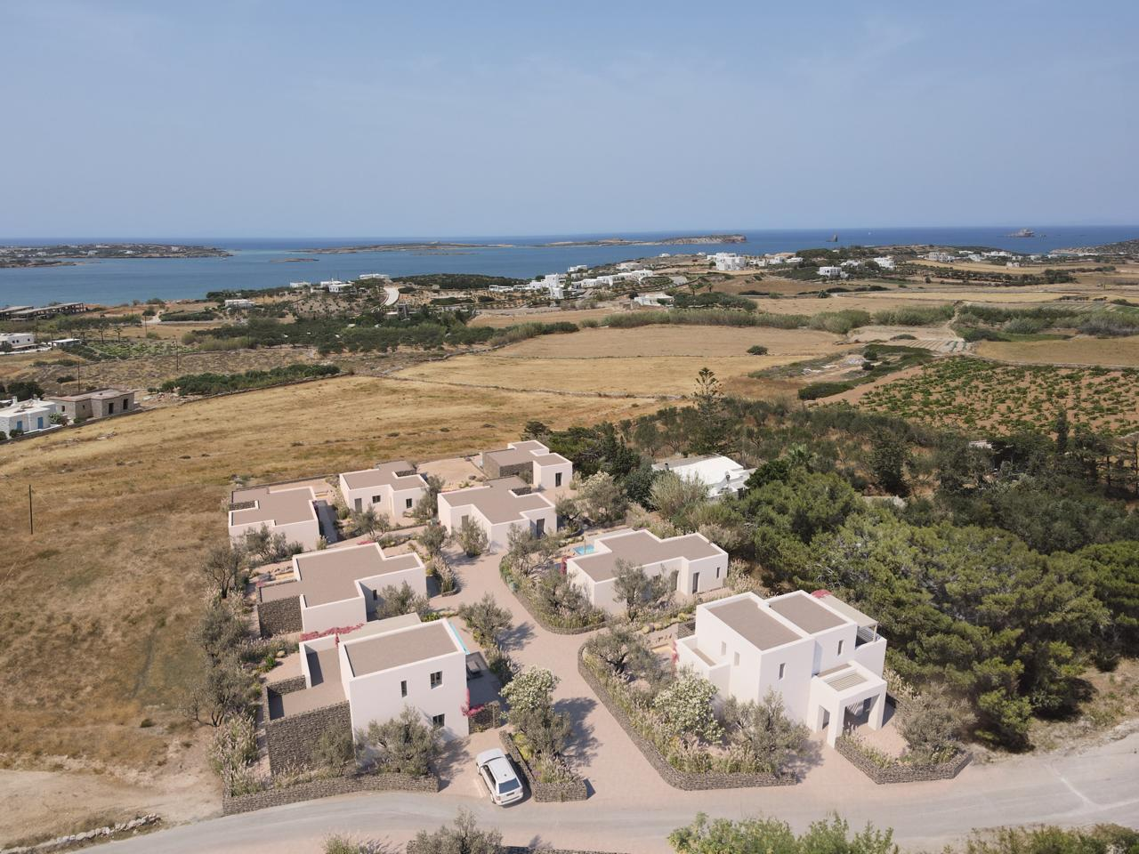
Mifras: A Unique Flagship Project
Our luxury villa project in Paros offers 8 unique villas, located in the beating heart of the island, within touching distance of the spectacular beaches and the main attractions. Each villa is carefully designed, and offers all the indulgences you are looking for: private pools, panoramic views, and modern design. This is your opportunity to invest in a luxury property on one of the most sought-after islands in Greece and guarantee yourself unforgettable vacations and a high return

Slide 2
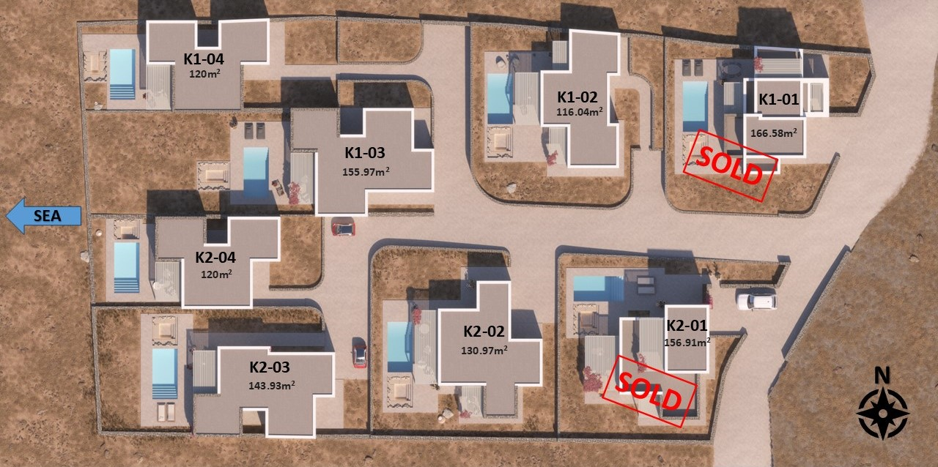

Slide 3
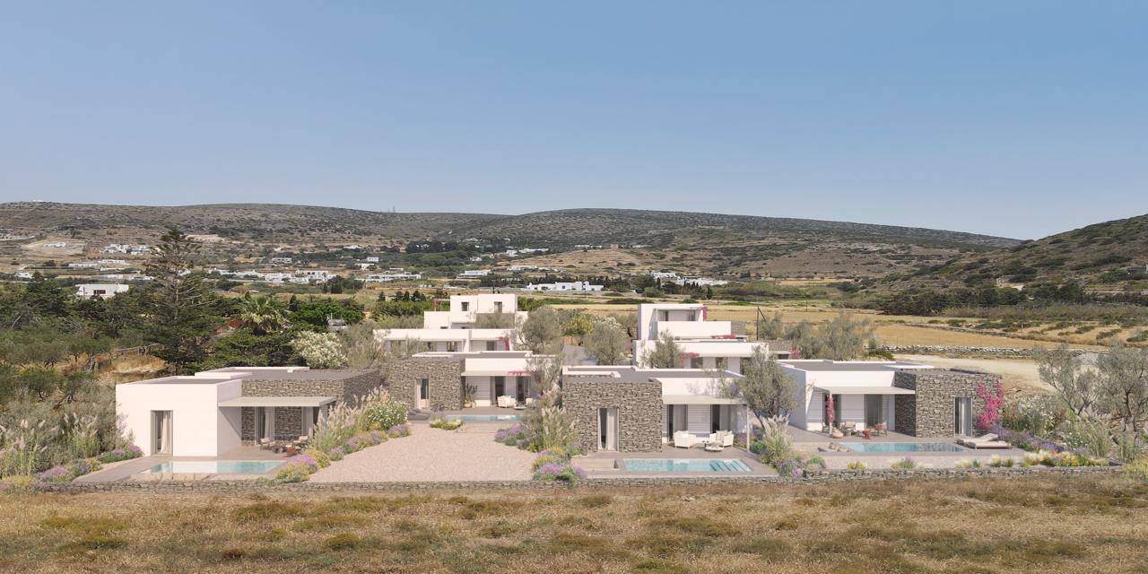
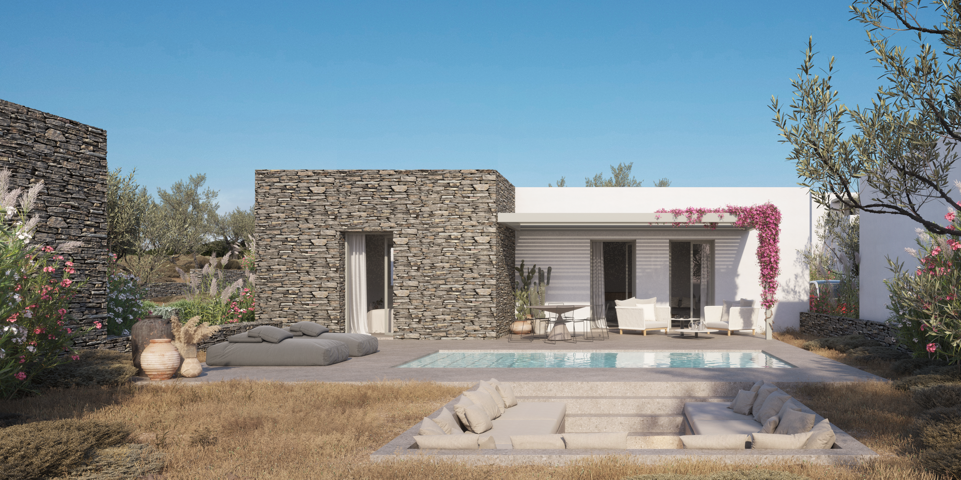
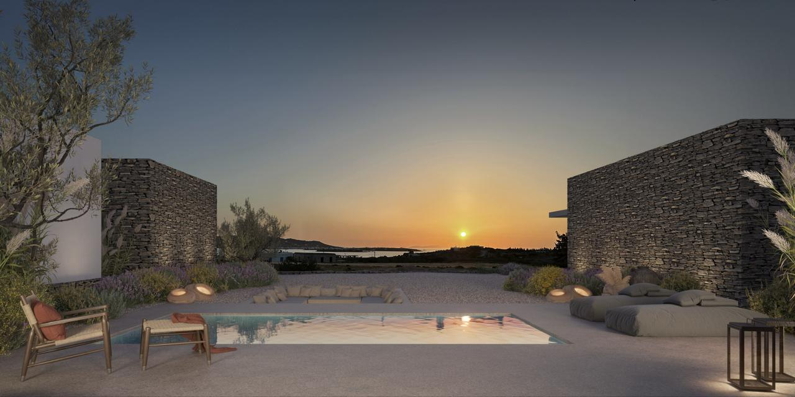
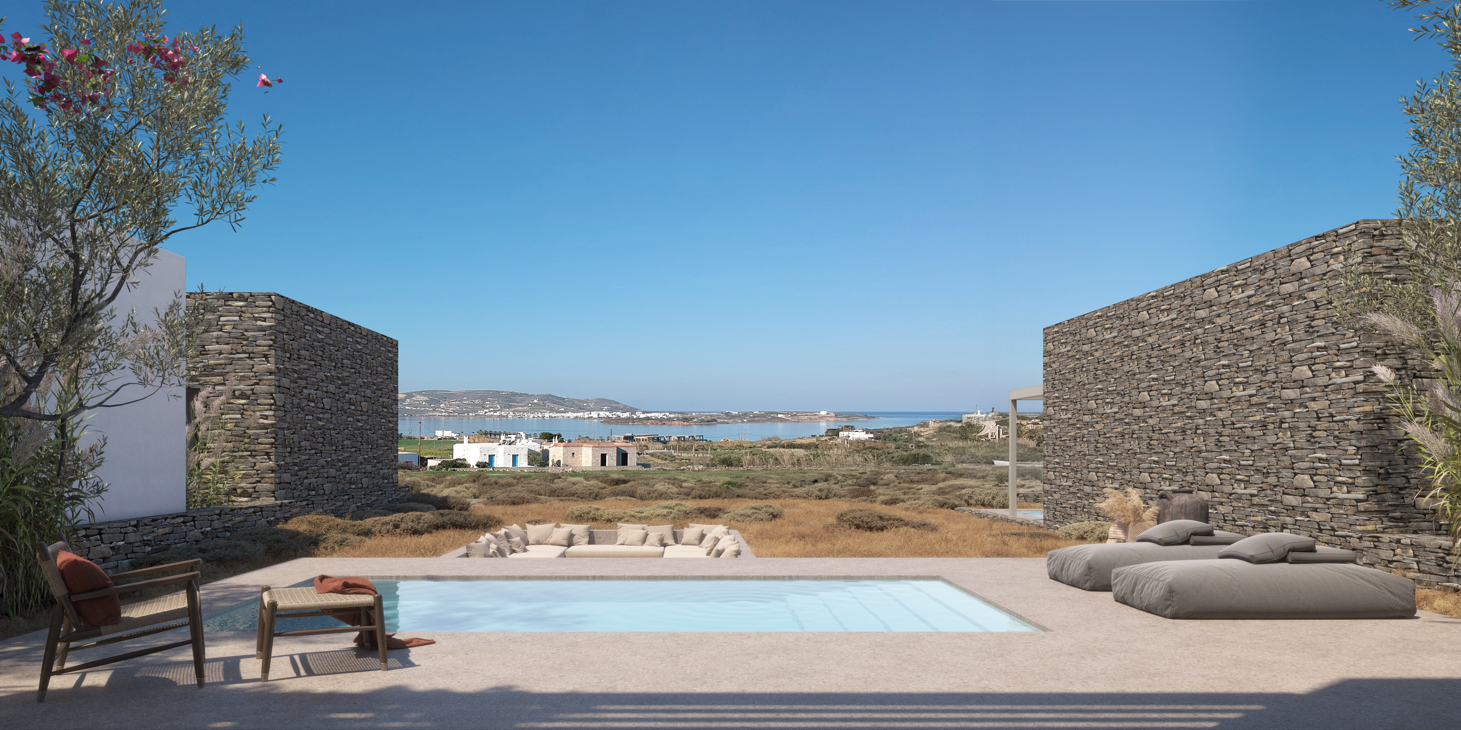

Slide 4
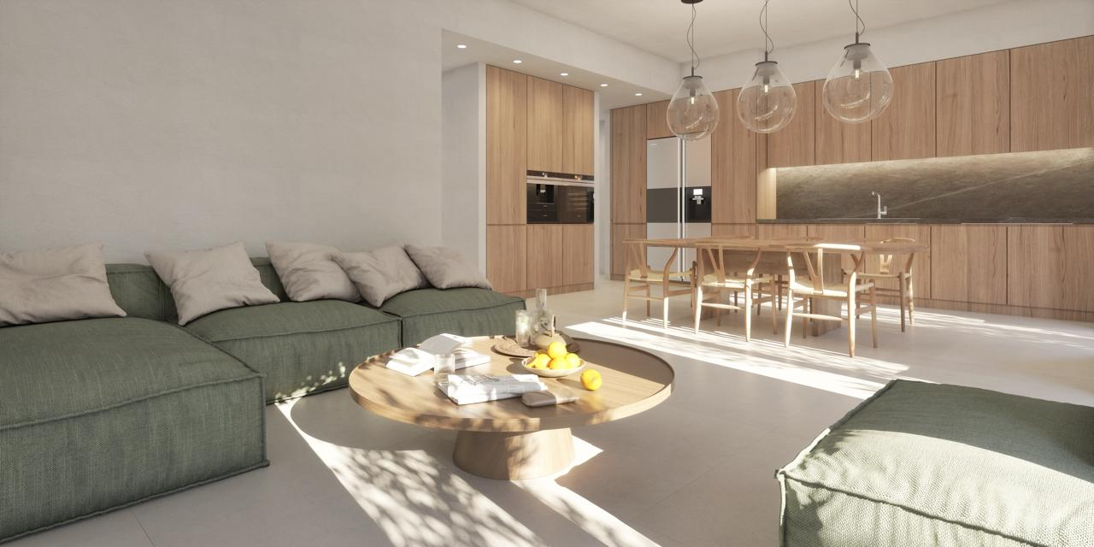
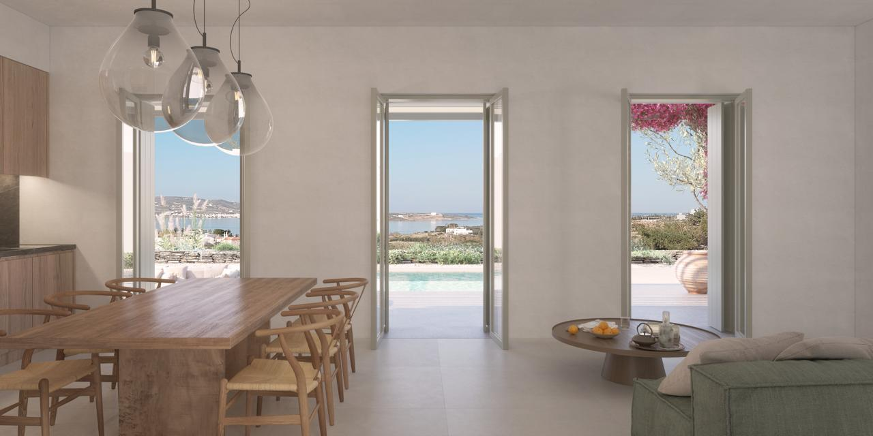
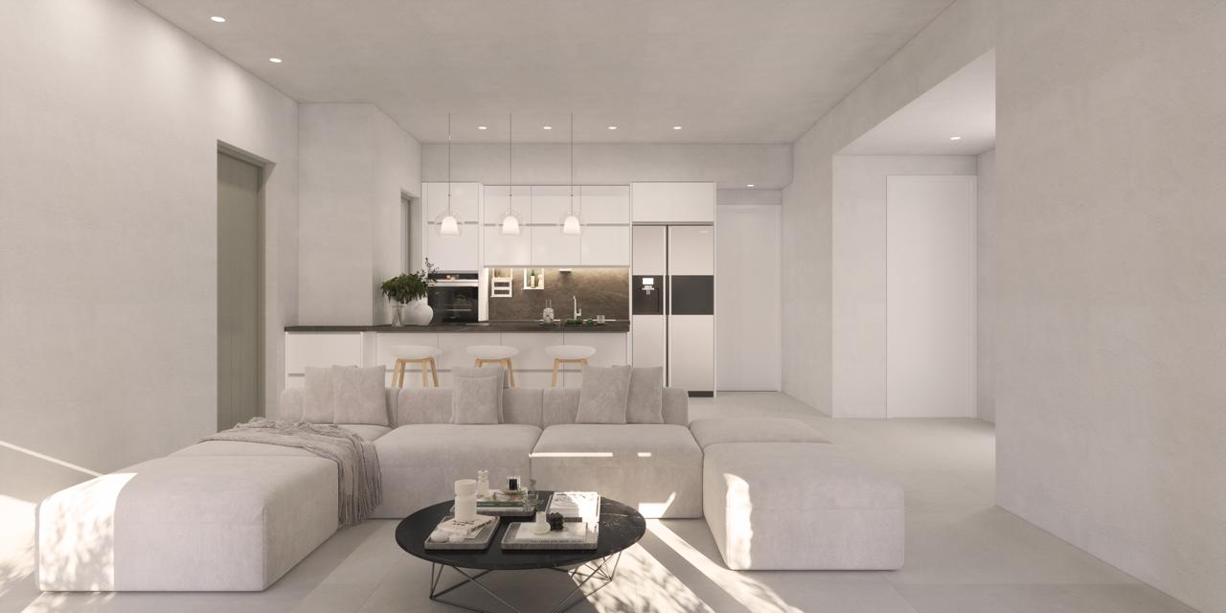
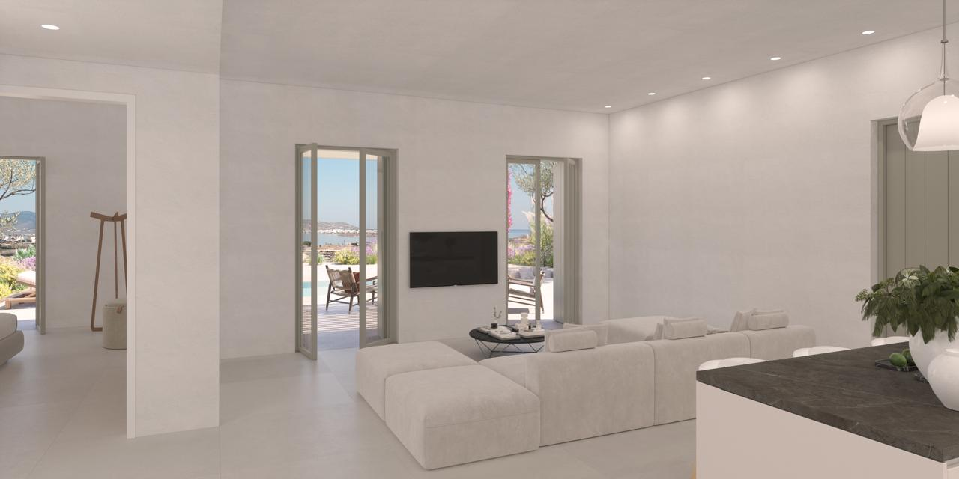

Slide 5
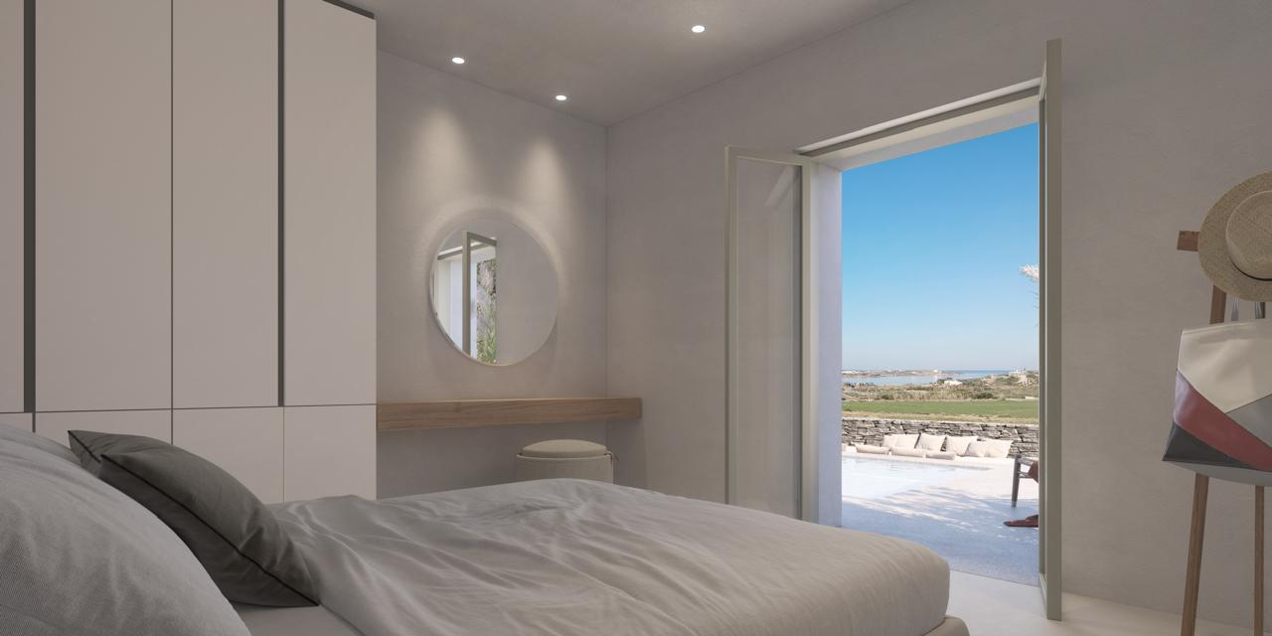
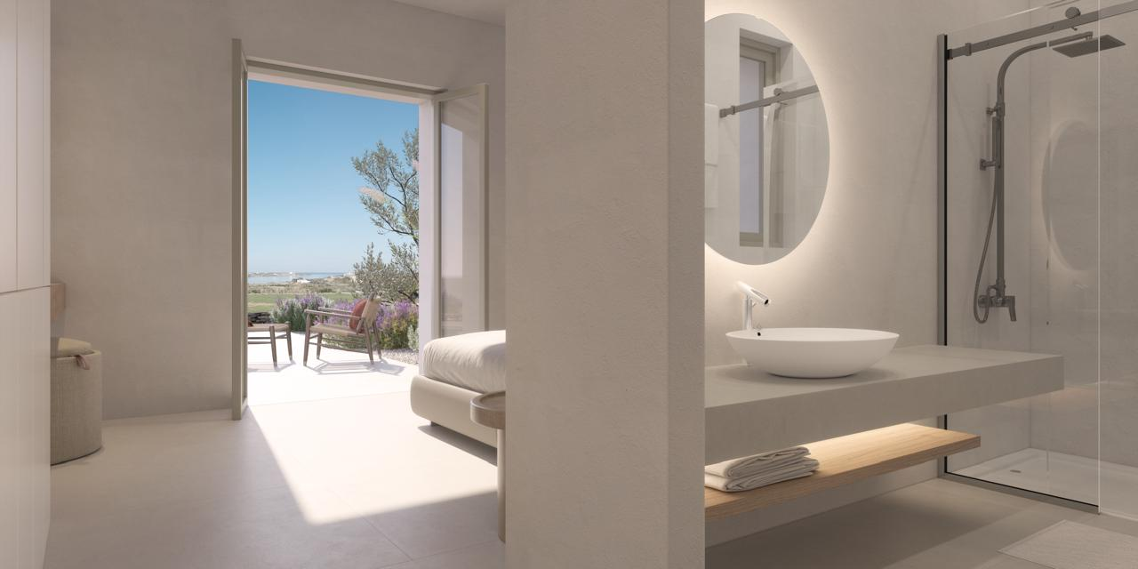
Villa K1-03 (B3) With Breathtaking Sea & Sunset View
Located in western Paros near Pounta, Within the city plan, overlooking the sea, Antiparos island & the sunset. 600m from the sea, 2km from the port of Pounta, 6km from the airport, 7 km from the port.
Under construction, to be delivered on April 30th 2026.
Delivered ready to move. Only thing missing are black & white appliances & furniture!
Land area: 577.56 sqm (privately owned – vertical property)
Built-up area: 155.97 sqm
Rooms: 3 master bedrooms with en-suite bathrooms, living room, dining room & kitchen area
https://maps.app.goo.gl/2hyZPm4mb2rXNuQdA
Included:
Stone Built Luxury Construction
Fully equipped bathrooms
Italian Kitchen furniture
Hidden Led Lighting in False Ceilings & all faucets
Full size (18 sqm) & Depth Pool
Private Parking
A/C in all rooms
Gardens Landscaping with automatic watering system
Solar water heating system
Wi-Fi
Alarm
Armored Door

Slide 7
VILLA K1-03

